Slide 1


WHOLE WELLNESS
INTRODUCTION TO
Psychology
EXPLORING MIND, BRAIN, AND BEHAVIOR.

Slide 2
1
INTRODUCTION
2
HISTORY OF PSYCHOLOGY
Agenda
3
BRANCHES OF PSYCHOLOGY
4
ASSESSMENT ACTIVITY
5
RECAP

Slide 3

Introduction
Have you ever wondered why changing certain habits is extremely difficult, or why some songs can spark instant nostalgia? If your answer is yes, then you’re already thinking like a psychologist!
Today, we’ll learn how psychology is silently guiding us through everyday choices, every single day.

Slide 4





Why it matters
Improves mental health and wellbeing
Strengthens relationships and promotes community building
Your discussion point goes here
Your discussion point goes here
Your discussion point goes here

Slide 5




History of Psychology
Roots
Psychology as a science
Item goes here
Item goes here
Greek philosophers begin studying how mind and behavior work
Wilhelm Wundt opens the first-ever experimental psychology laboratory
Briefly explain the discussion point here.
Briefly explain the discussion point here.

Slide 6



Branches of Psychology
Clinical Psychology
Item goes here
Item goes here
Integrates science and theory into the study and treatment of human disability and discomfort
Briefly explain the discussion point here.
Briefly explain the discussion point here.

Slide 7

Assessment Activity
Answer the questions that follow to assess your understanding of the lesson so far

Slide 8
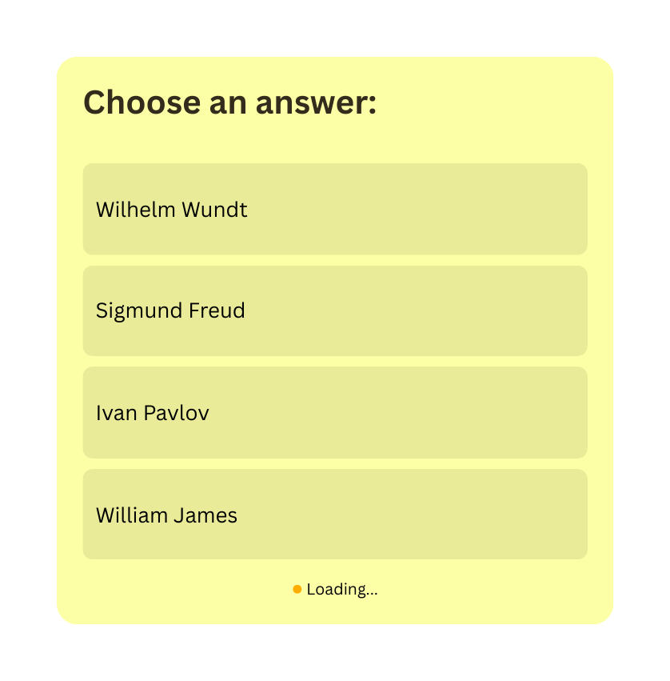
Question:
Who is regarded as the father of psychology?
Hint: He opened the first-ever experimental psychology laboratory in Leipzig, Germany.

Slide 9
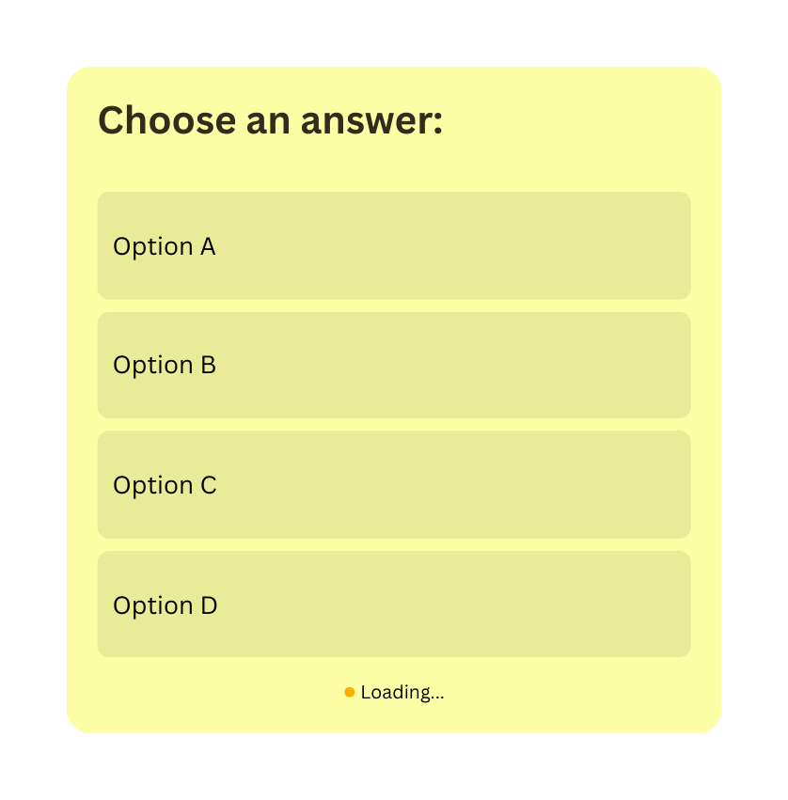
Question:
Question goes here

Slide 10



Psychology
The scientific study of the human mind and behavior
Recap
Key point here
Briefly explain the discussion point here.
Key point here
Briefly explain the discussion point here.

Slide 11

“The greatest discovery of my generation is that a human being can alter his life by altering his attitudes of mind.”
— William James

Slide 12

Get in touch
Email
hello@reallygreatsite.com
Social media
@reallygreatsite
Phone
123-456-7890
Address
123 Anywhere St., Any City,ST 12345

Slide 13









Resource Page
Use these in your presentation. Delete or hide this page before presenting.
Fonts
Design Elements / Icons
This presentation template
uses the following free fonts:
TITLES:
Cormorant Garamond
BODY TEXT:
Inter Regular, Semibold
You can find these fonts online too.
Colors
#FDFFA6
#C44900
#332C1D
#1B3122
#000000

Slide 14

Credits
This presentation template is free for everyone to use, thanks to the following:
Pexels, Pixabay, & Sketchify
for this presentation template
for the photos, graphics, and elements
Happy designing!

